Slide 1
FORECASTING GOLD PRICES
TEAM
LOKESH.P
Vilas.T
RUKHSAR.T
AKSHAY.R
DARSHANA.Y
FACULTY GUIDE
VARUN
HIMAVANTH

Slide 2
BUSINESS OBJECTIVE
DATA PROVIDED IS RELATED TO GOLD PRICES. THE OBJECTIVE IS TO UNDERSTAND THE UNDERLYING STRUCTURE IN YOUR DATASET AND COME UP WITH A SUITABLE FORECASTING MODEL WHICH CAN EFFECTIVELY FORECAST GOLD PRICES FOR NEXT 30 DAYS.
THIS FORECAST MODEL WILL BE USED BY GOLD EXPORTING AND GOLD IMPORTING COMPANIES TO UNDERSTAND THE METAL PRICE MOVEMENTS AND ACCORDINGLY SET THEIR REVENUE EXPECTATIONS.

Slide 3
PROJECT ARCHITECTURE
Step-1 : Data set details collection
Step-2 : Data cleaning
Step-3 : EDA phase
Step-4 : Models Building(Build as many as u can)
Step-5 : Finalize best model.
Step-6 : Compare actual and predicted values.
Step-7 : Deploy the finalized model and draw insights for that.(USING sTREAMLIT)

Slide 4
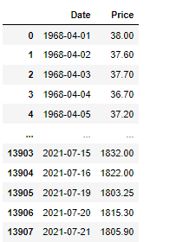
DATA SET COLLECTION & CLEANING
13908 rows & 2 column
Year range 01-04-1968 to 21-07-2021
Unique Date 13908 and Price 7840
Null value 431
These are the explanations for variables.
1) Date (object) : Daily entry date
2) Price (Float64) : Gold Price

Slide 5
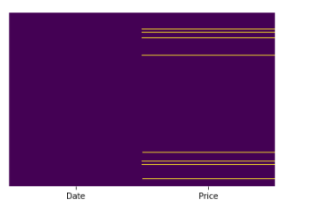
EDA(exploratory data analysis)
Null value Heatmap
In this map we see Price null value.

Slide 6
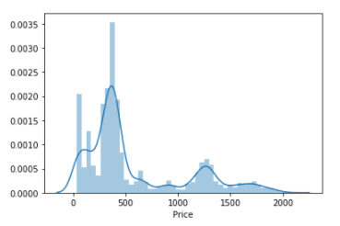
DISTPLOT OF PRICE DENSITY

Slide 7
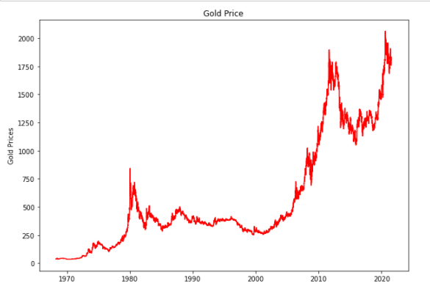
Line plot of Gold Price

Slide 8
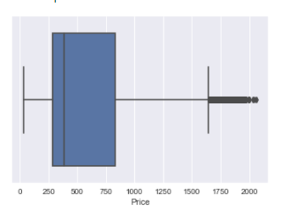
BOXPLOT FOR PRICE

Slide 9
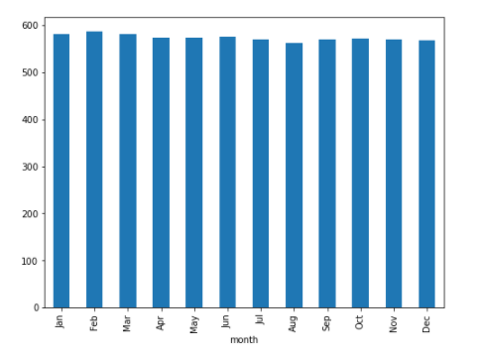
BARPLOT FOR MONTH WISE

Slide 10
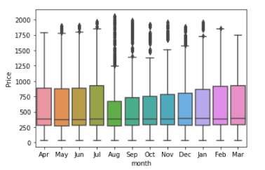
BOXPLOT for MONTHS :-

Slide 11
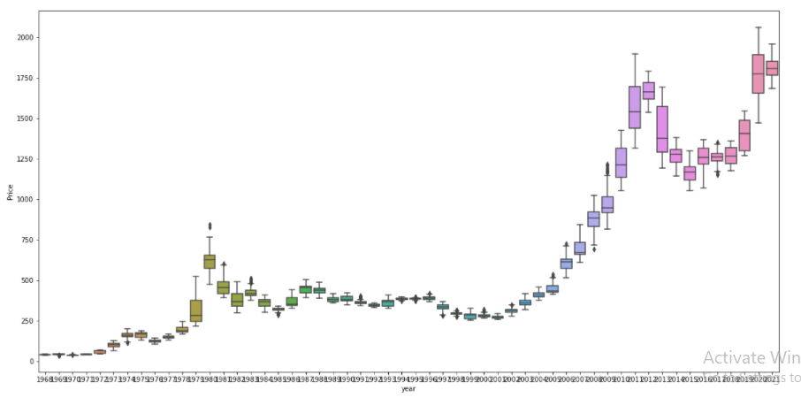
BOXPLOT OF YEAR

Slide 12
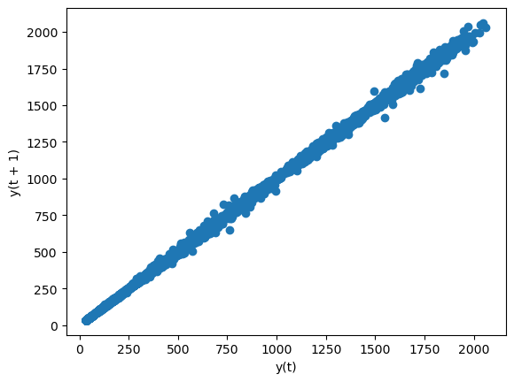
LAG PLOT

Slide 13
MODEL BUILDING
Here we performed various MODEL BUILDING techniques
K NEAREST NEIGHBOUR(KNN)
LIGHT GRADIENT BOOSTING MACHINE(LGBM)
RANDOM FOREST REGRESSOR(RF)
DECISION TREE REGRESSOR(DT)
GRADIENT BOOSTING REGRESSOR(GBR)
EXTRA TREE REGRESSOR(ET)
ADA BOOST REGRESSOR(ADA)
LASSO LEAST ANGLE REGRESSOR(LLA)
MULTI LINEAR REGRESSION(MLR)

Slide 14
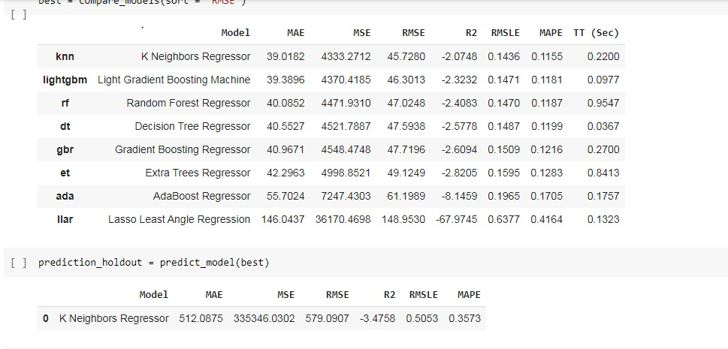
RMS VALUE OF THE MODEL BUILDING TECHNIQUE

Slide 15
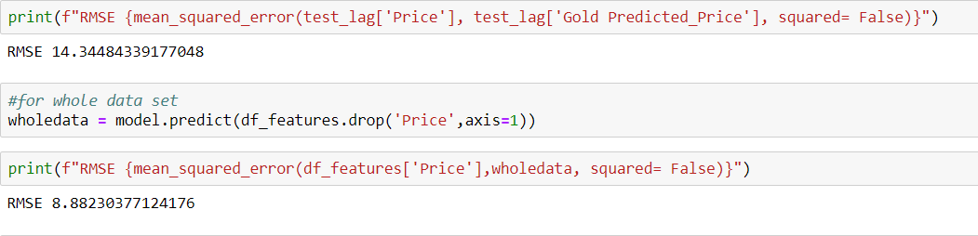
MODEL FINILIZE
As we have seen the RMS values of the models, all the models have more RMS value than ML regression model.
So we decided to use ML regression model for our FORCASTING.

Slide 16
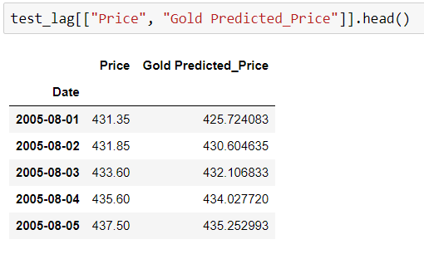
PREDICTED VALUES of TEST DATA
We can see that there is no much difference in the actual and predicted values
So we finalize this technique to build our model to forecast the future gold price

Slide 17
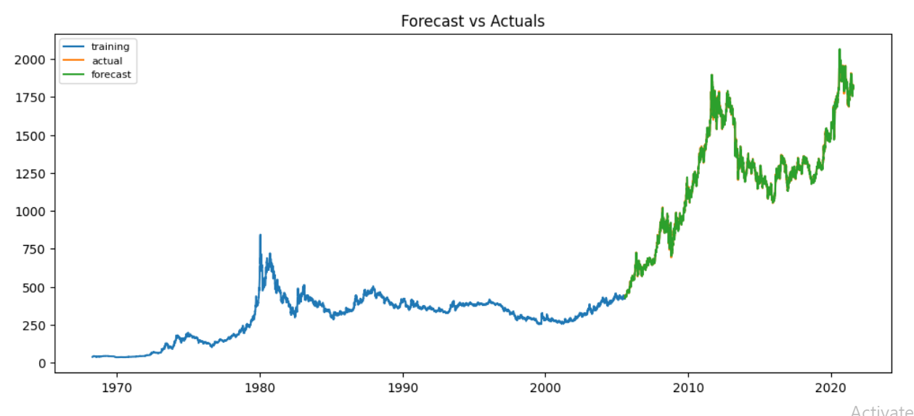
FORCASTING V/S ACTUAL VALUES

Slide 18
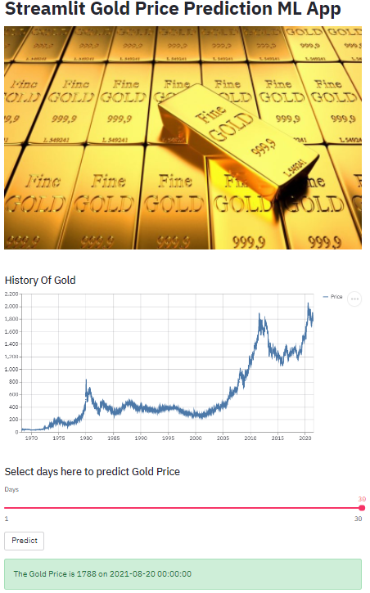
DEPLOYMENT (using STREAMLIT)
The final deployment page of our model looks like

Slide 19
CHALLENGES FACED
RESEARCH ON HISTORY OF GOLD
DECIDING MODEL BUILDING TECHNIQUE

Slide 20
HOW CHALLENGES OVERCOMED
RESEARCH ON HISTORY OF GOLD :
As we are not much aware of the gold price we have done a lot of research to find out the gold price history.
We as a team worked so hard to get the knowledge on the previous year gold price data.
Which helps us to do the project more effectively.

Slide 21
DECIDING MODEL BUILDING TECHNIQUE
As we tried many model building techniques every model don’t have such a significant difference in the output
We are little bit worried about the output results that we got.
But we again overcame this as a team, Everyone has worked really hard on this part and we finally build a model that best suits the data .

Slide 22
THANK YOU

